Slide 1

Real TIME EMOTION DETECTION
Team: Sudhan Manovah , Vikas Raj , Vani Balla , Harpreet Kaur

Slide 2
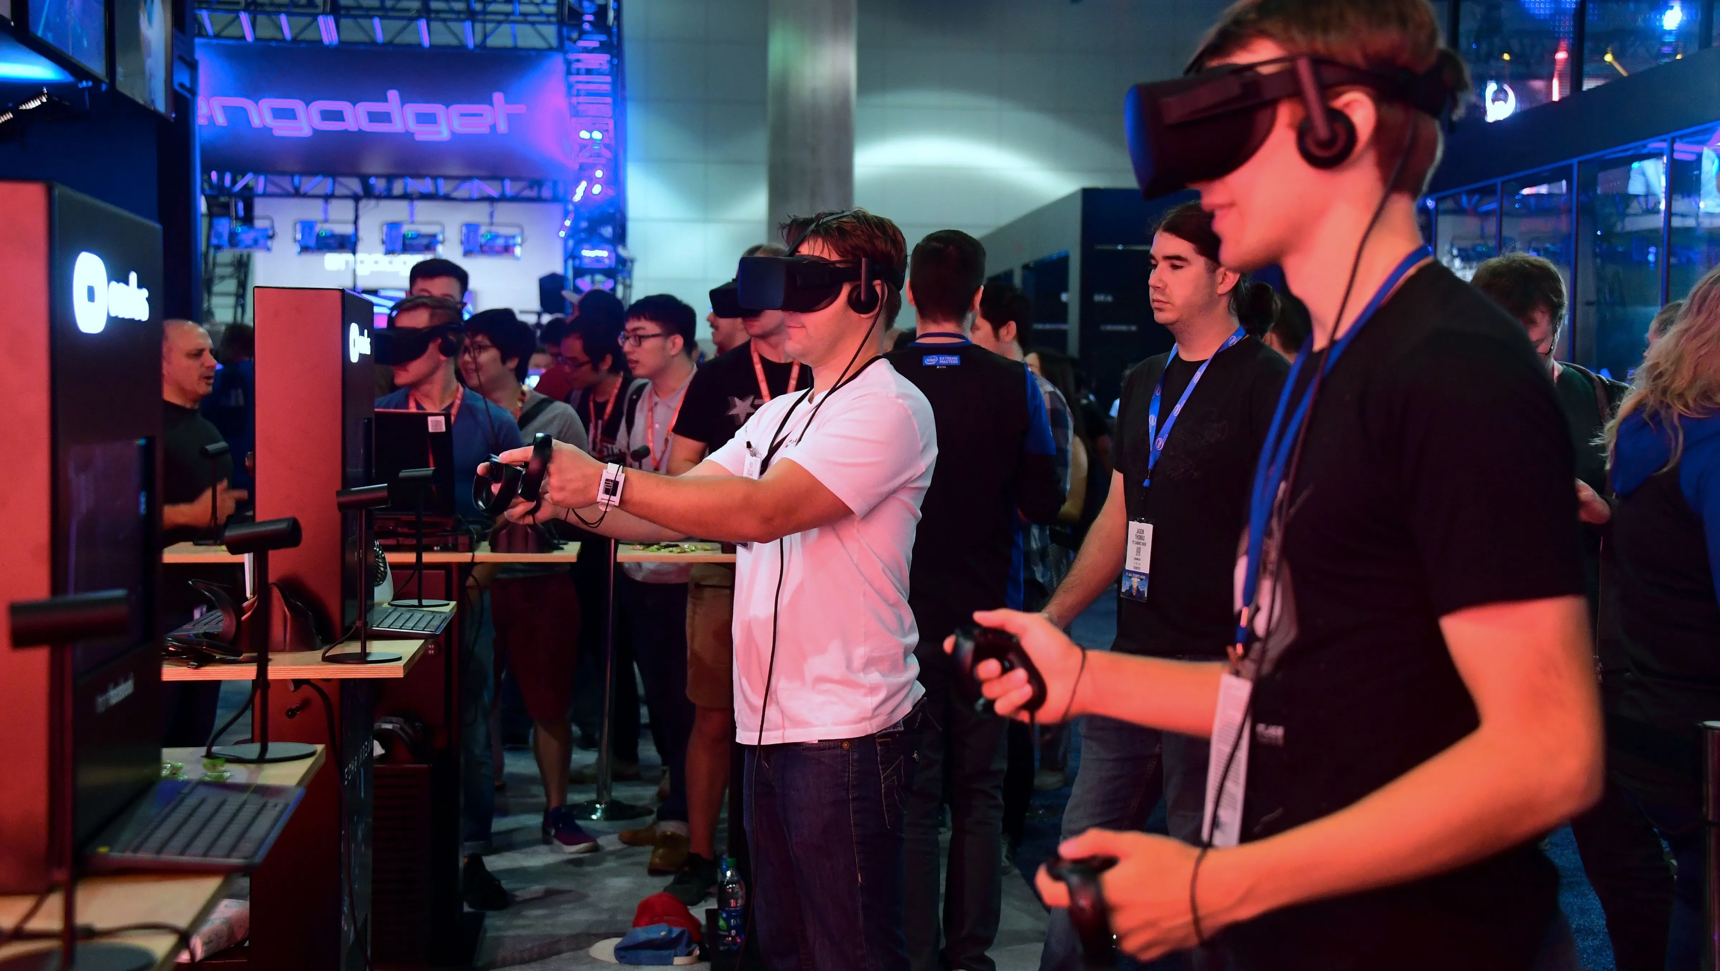

INTRODUCTION
Video games are bigger than movies and music combined, and the industry is still expanding.
Over 2 billion people worldwide - around 26% of the global population - play video games.
The video game industry is a $260 billion revenue generator, and tech giants like Google, Meta, and Apple are eager to jump in.
Console – PlayStation , Xbox , Nintendo
Mobile – Android , IOS
PC – Windows , Mac OS
AR/VR - Microsoft’s HoloLens , Meta Quest 2

Slide 3


Feedback are collected through a variety of channels to help game developers and publishers understand what players thought of the game and how it can be improved before its final release.
In-game review prompts
Surveys
Social media
Direct feedback
Emotion Detection in game play?

Slide 4

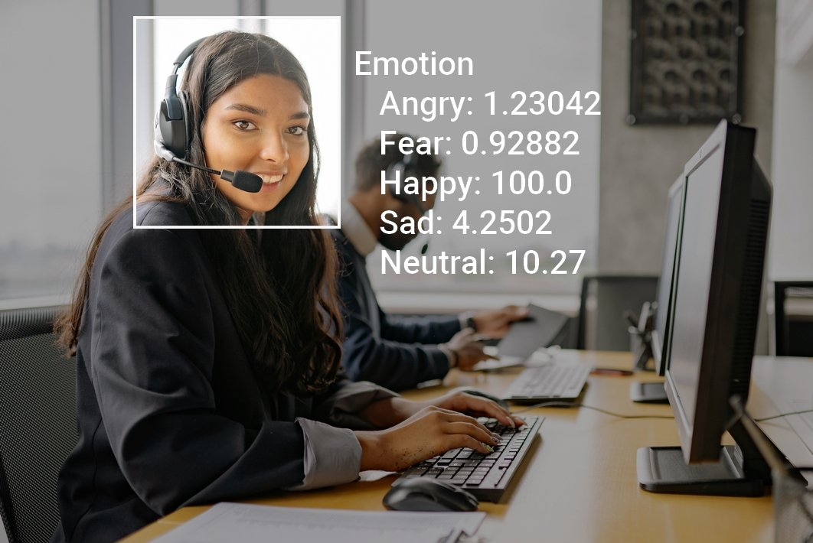
Legal consent to record
A system that comes with a camera capable of recording video can be used to capture and store visual content.
A system designed to analyze emotions and store information in a database.
To identify areas of the game that cause frustration or
disinterest among players.
Help game developers and publishers to tailor
marketing messages, game difficulty levels, or
other game features to specific player segments.
Lot of excitement during a specific part of the game -
Can be used to develop similar games or products
that are likely to appeal to interests.

Slide 5
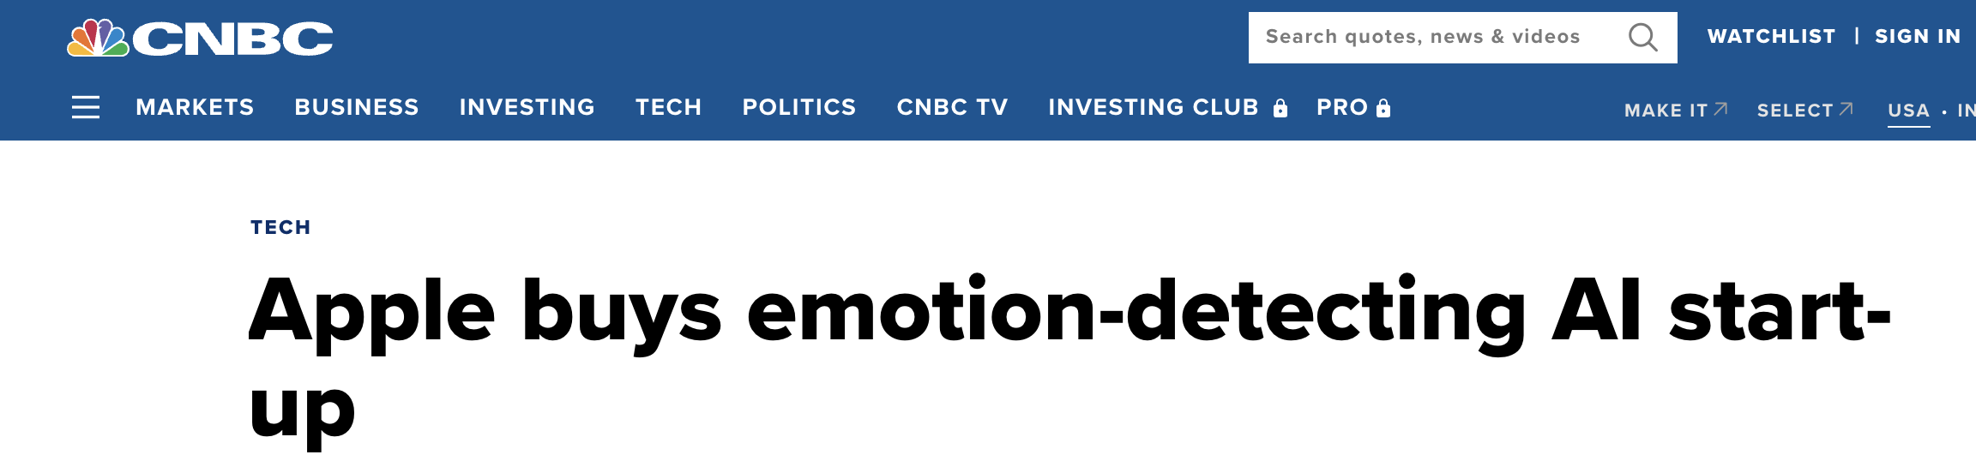
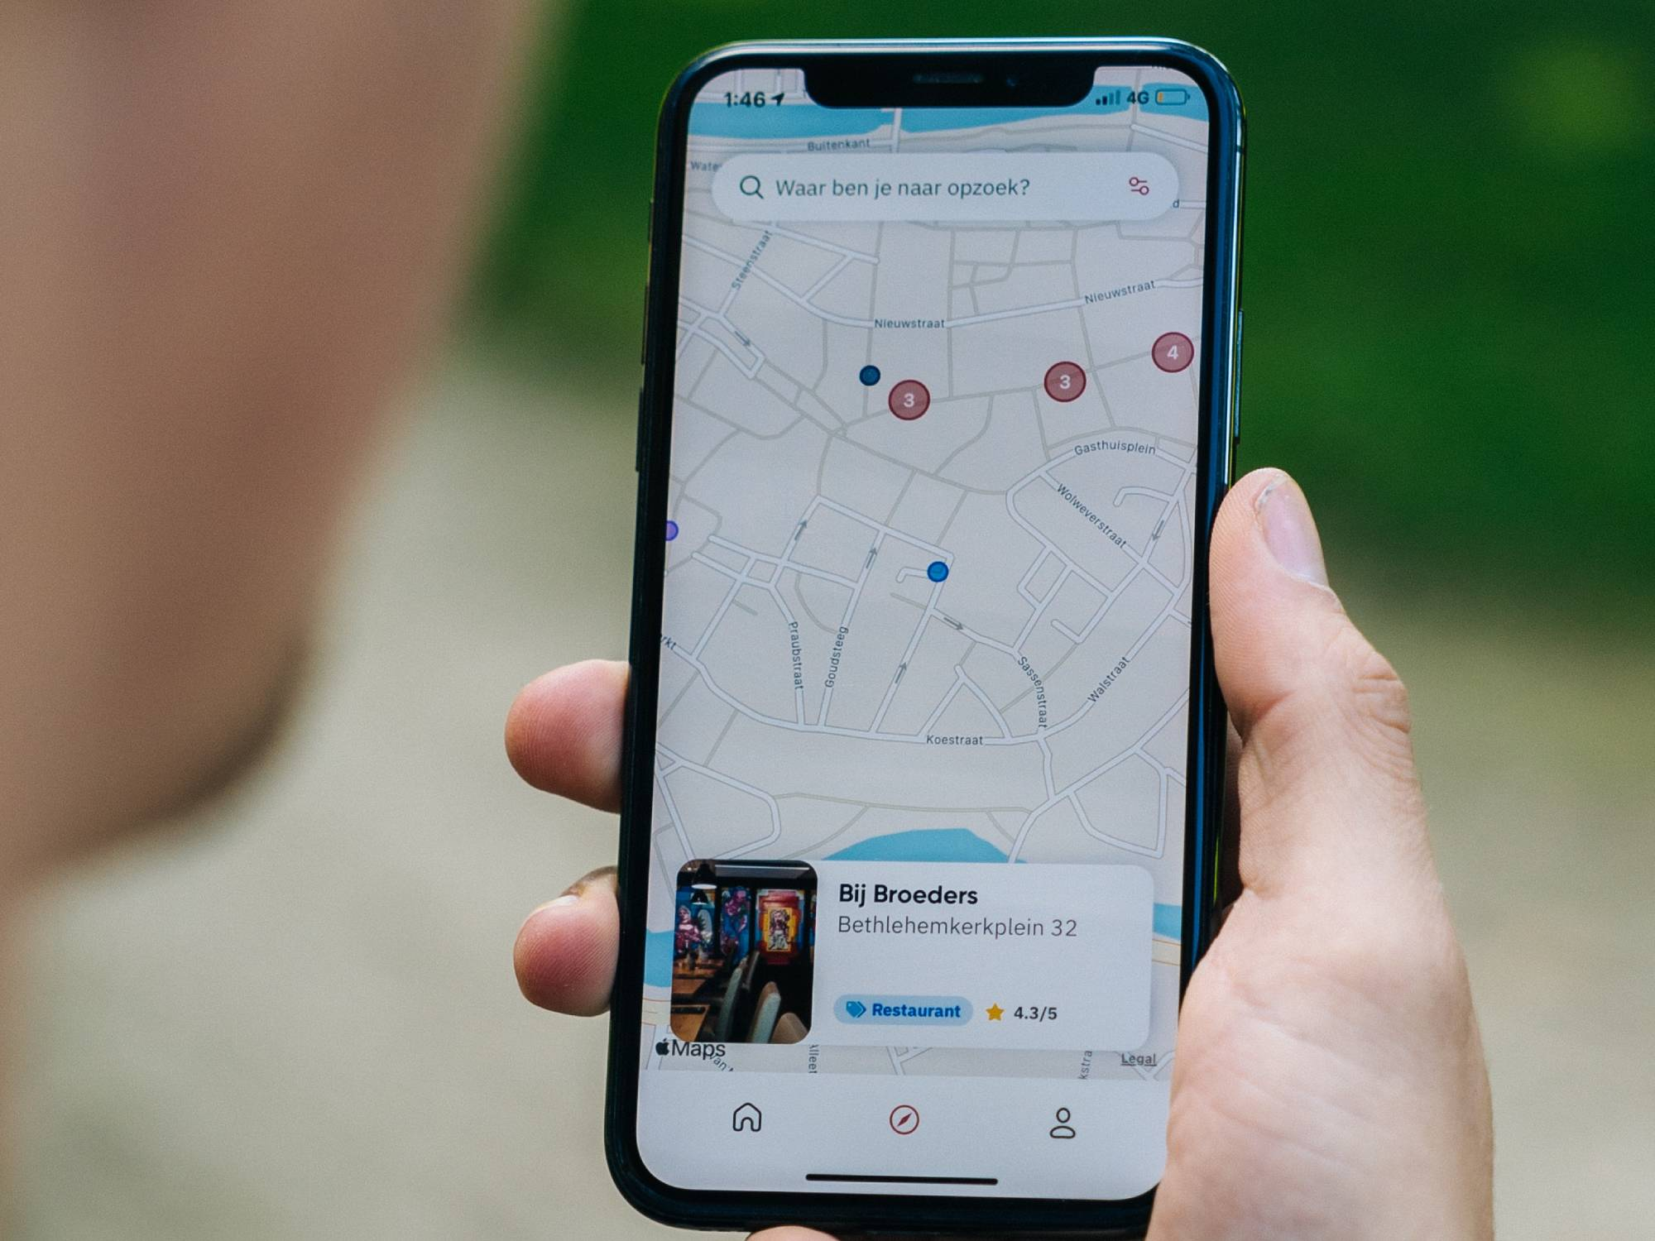
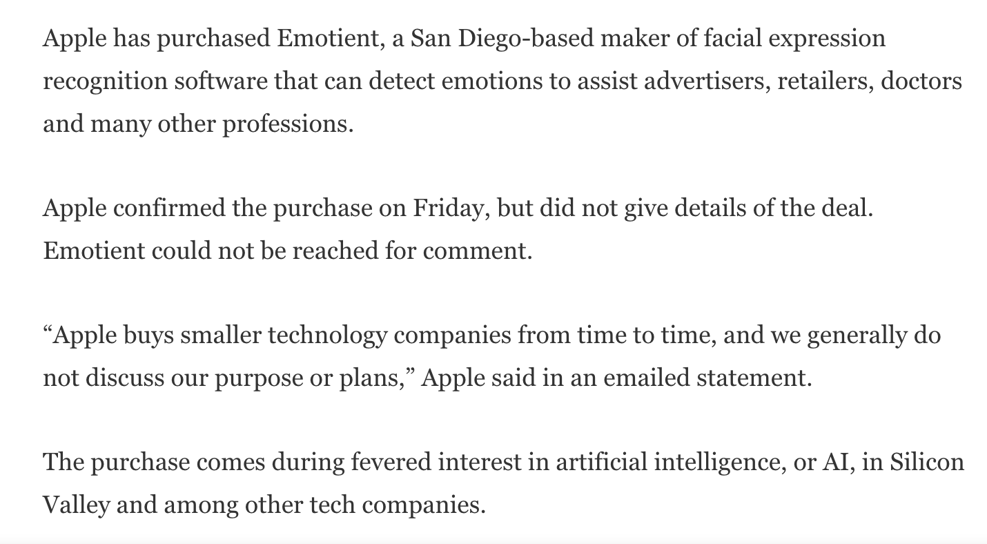

Slide 6
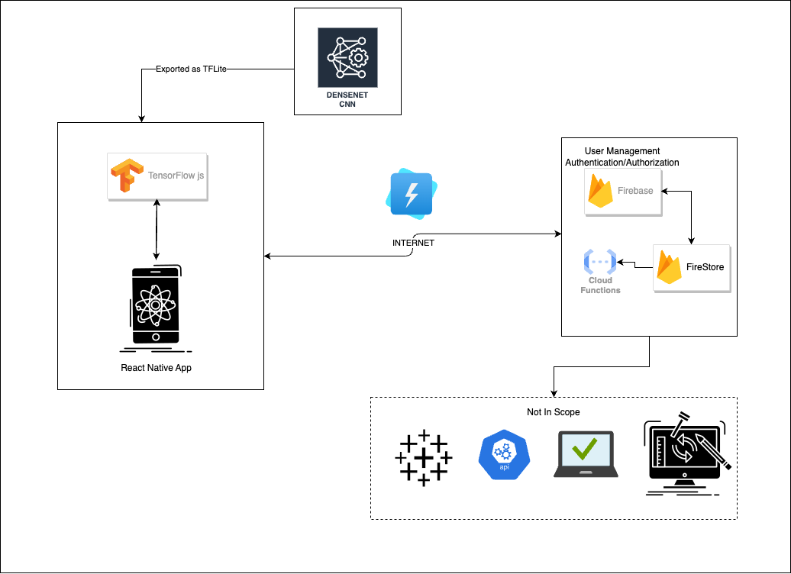
High Level Architecture

Slide 7
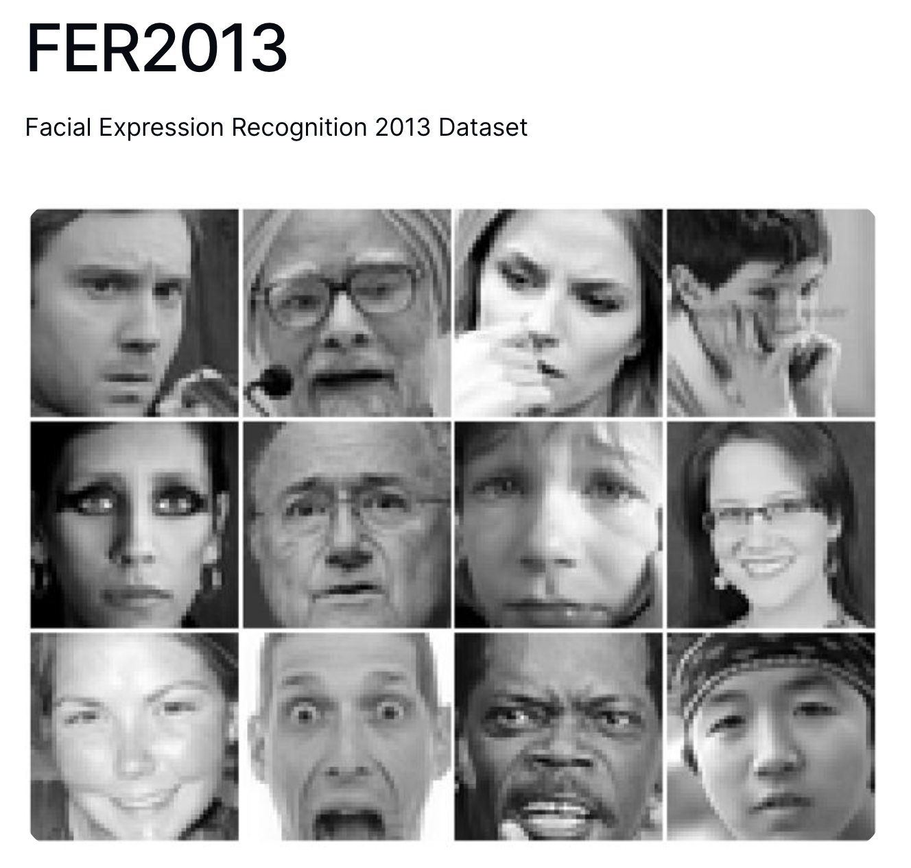
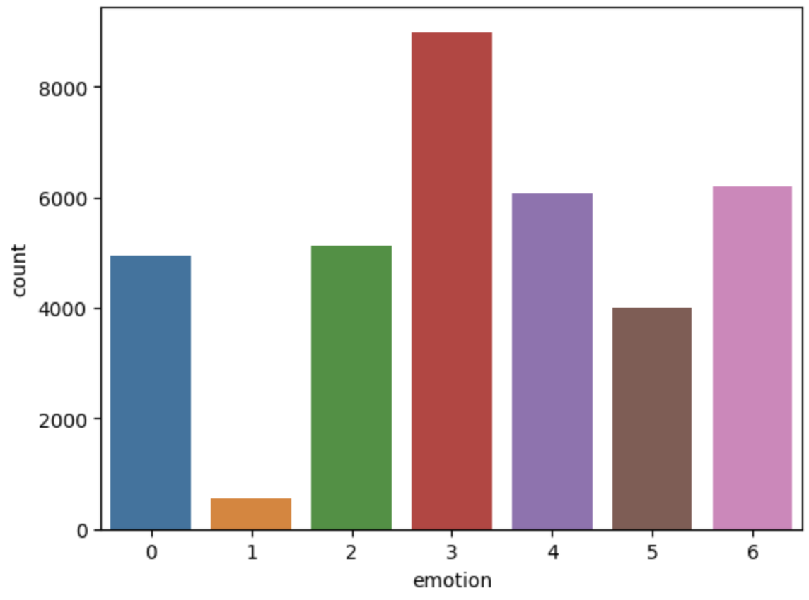
DATASET
FER-2013 is a dataset consisting of 35,887 grayscale images of faces, each labeled with one of seven facial expressions: anger, disgust, fear, happiness, sadness, surprise, and neutral.
The dataset was created in 2013 by Pierre-Luc Carrier and Aaron Courville for the purpose of training and testing algorithms for facial expression recognition.

Slide 8
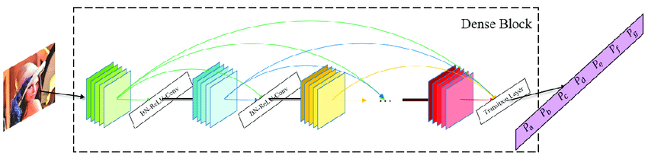
Dense Net
Real-time emotion recognition applications require low-latency, energy-efficient solutions that can run on a wide range of devices.
This architecture has a total of 23 layers, including 6 Conv2D layers, 6 Batch Normalization layers, 3 MaxPooling2D layers, 4 Dropout layers, 1 Flatten layer, and 2 Dense layers.
ImageDataGenerator in is used to generate batches of augmented image data in real-time during model training.
The image data generator transforms raw images randomly with rotations, zooms, flips, etc., generating new images on-the-fly. This augments training data with extra information.

Slide 9
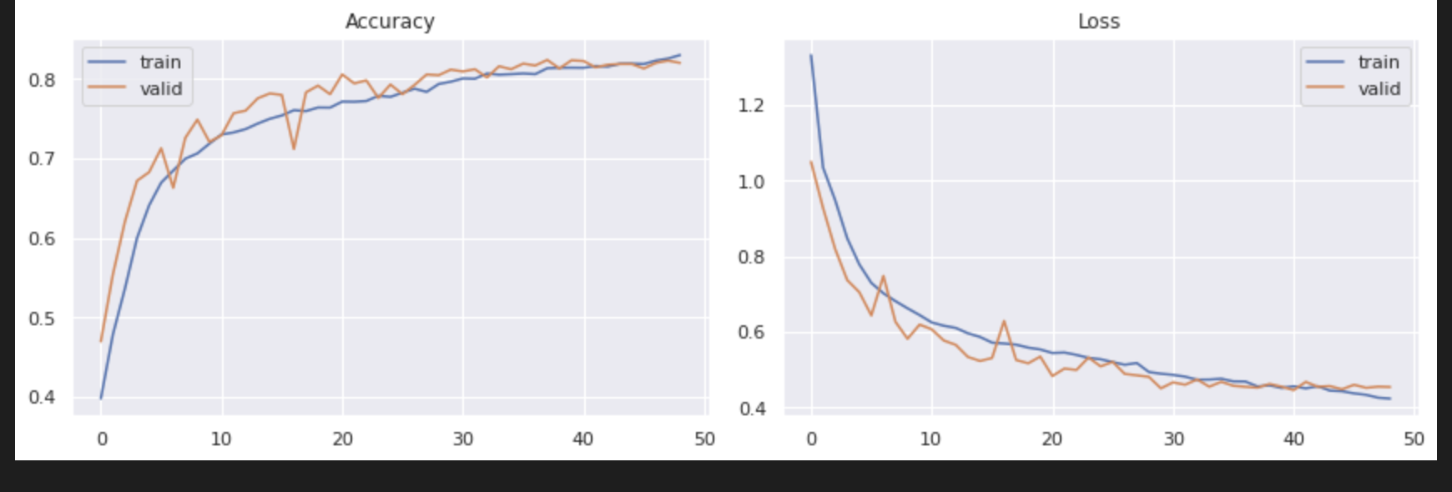
Results
The model achieved a training accuracy of 83.03% with a loss of 0.4256 and a validation accuracy of 82.04% with a loss of 0.4542.
The model was trained for a total of 49 epochs with a learning rate of 0.0010.

Slide 10
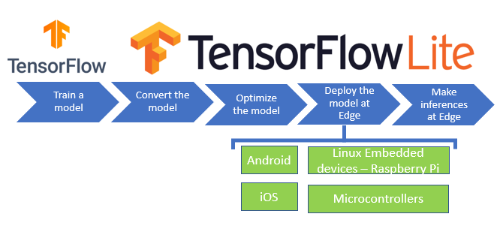
Export the Model
Exporting a CNN model to TensorFlow Lite (TFLite) is good option for using the model in mobile or edge devices. TFLite is a lightweight and optimized version of TensorFlow designed specifically for mobile and embedded devices.
Use the TFLiteConverter to convert the model to the TFLite format.
Save the TFLite model to a file.

Slide 11

React Native Development
Key Components
In React Native project, installed the @tensorflow/tfjs-react-native library to use TensorFlow.js in the app.
Load the TFLite model in the React Native app.
Summarized – other code to get the camera stream to pass through the model and draw predictions on canvas

Slide 12

Google’s Fire Base
Firebase is a popular Backend-as-a-Service (BaaS) platform provided by Google that offers a suite of tools and services for building and managing web and mobile applications.
Real-time database
Easy authentication
Cloud functions for backend logic
Simple and scalable hosting
Analytics and performance monitoring

Slide 13
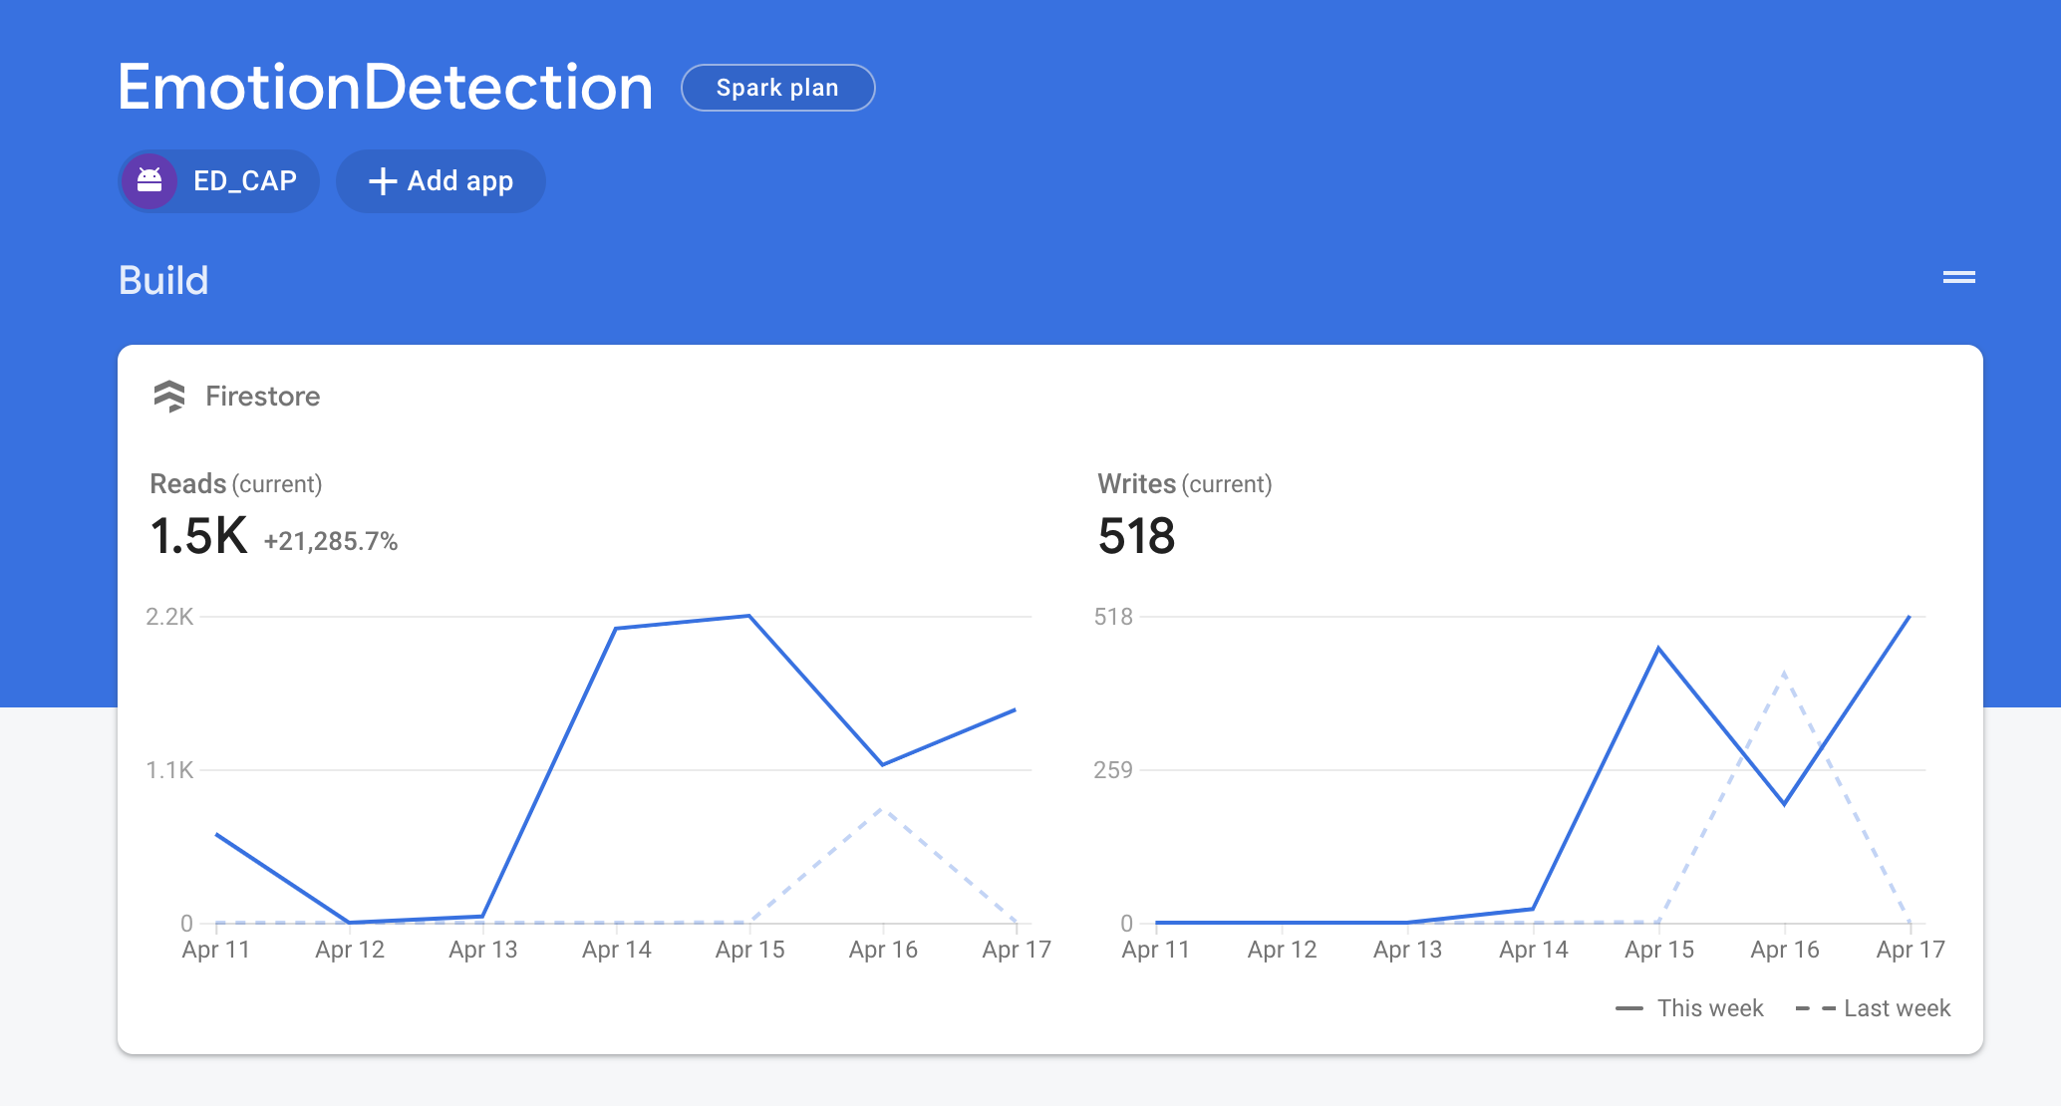
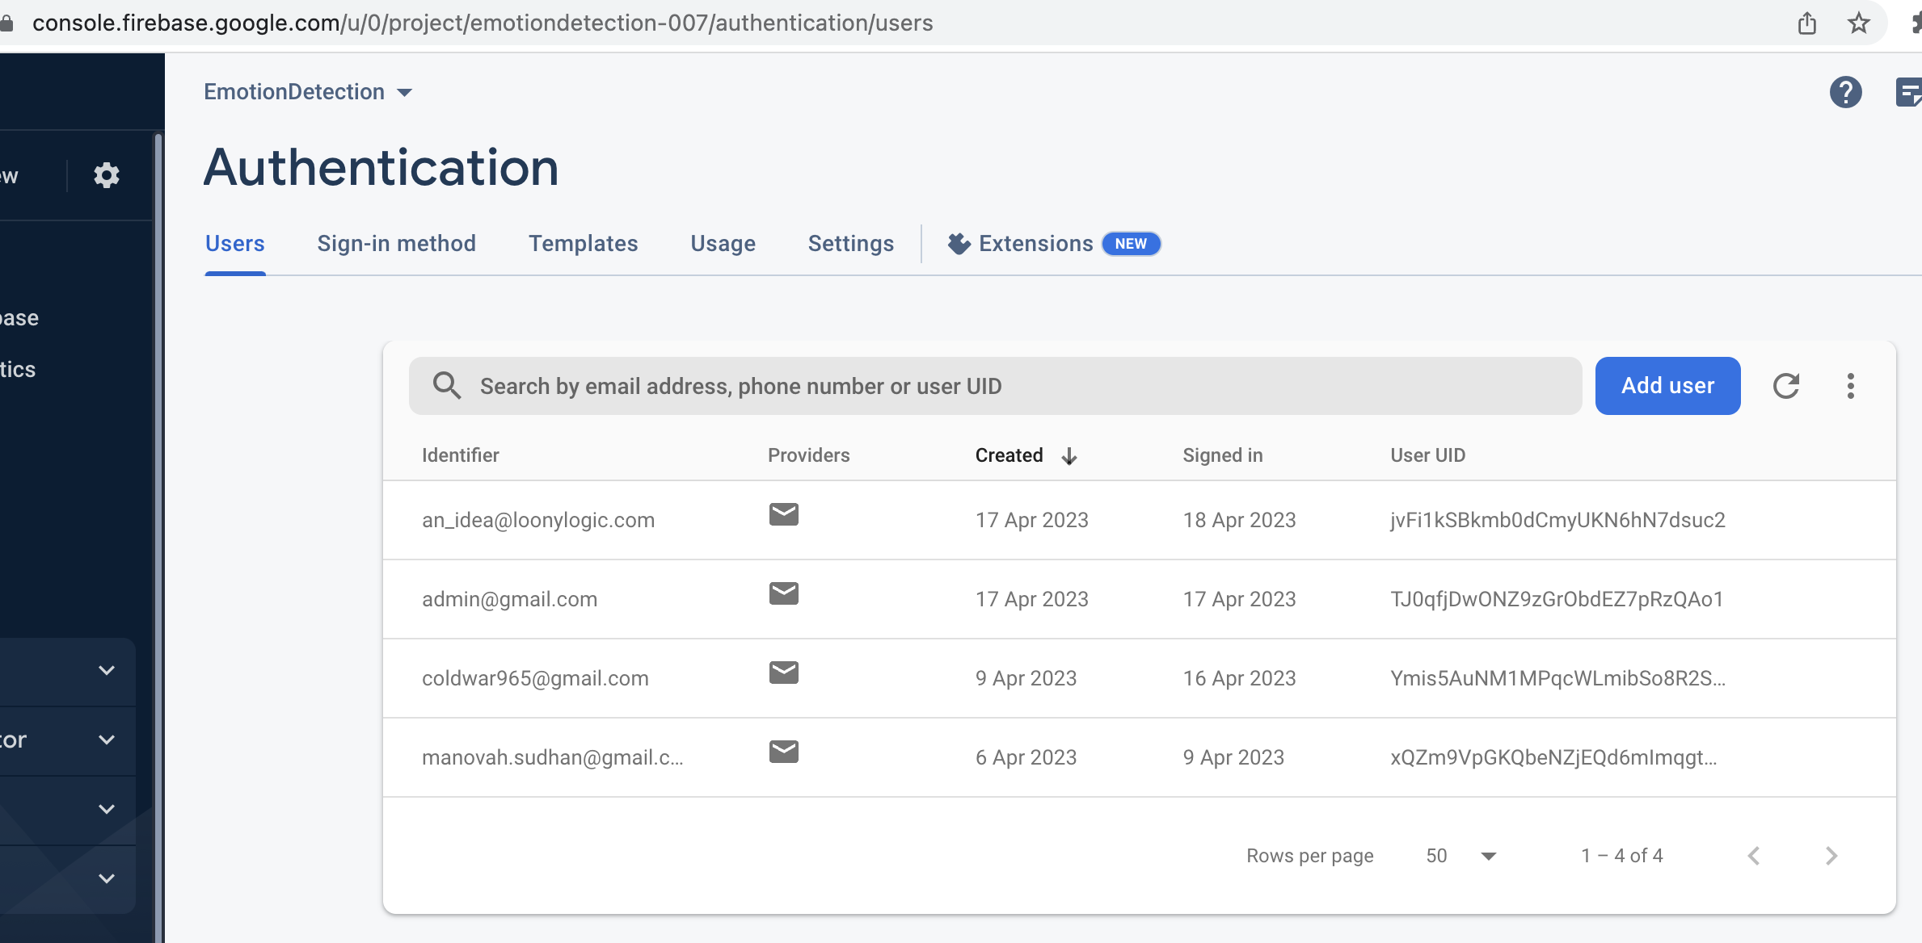
Realtime Database
Authentication
Cloud Functions
Cloud Storage
Hosting
Performance monitoring & Analytics
Firebase SDK integrated into React Native app
Authentication methods used: password-based, Google, and Facebook
Firebase used to handle user authentication in the app.

Slide 14
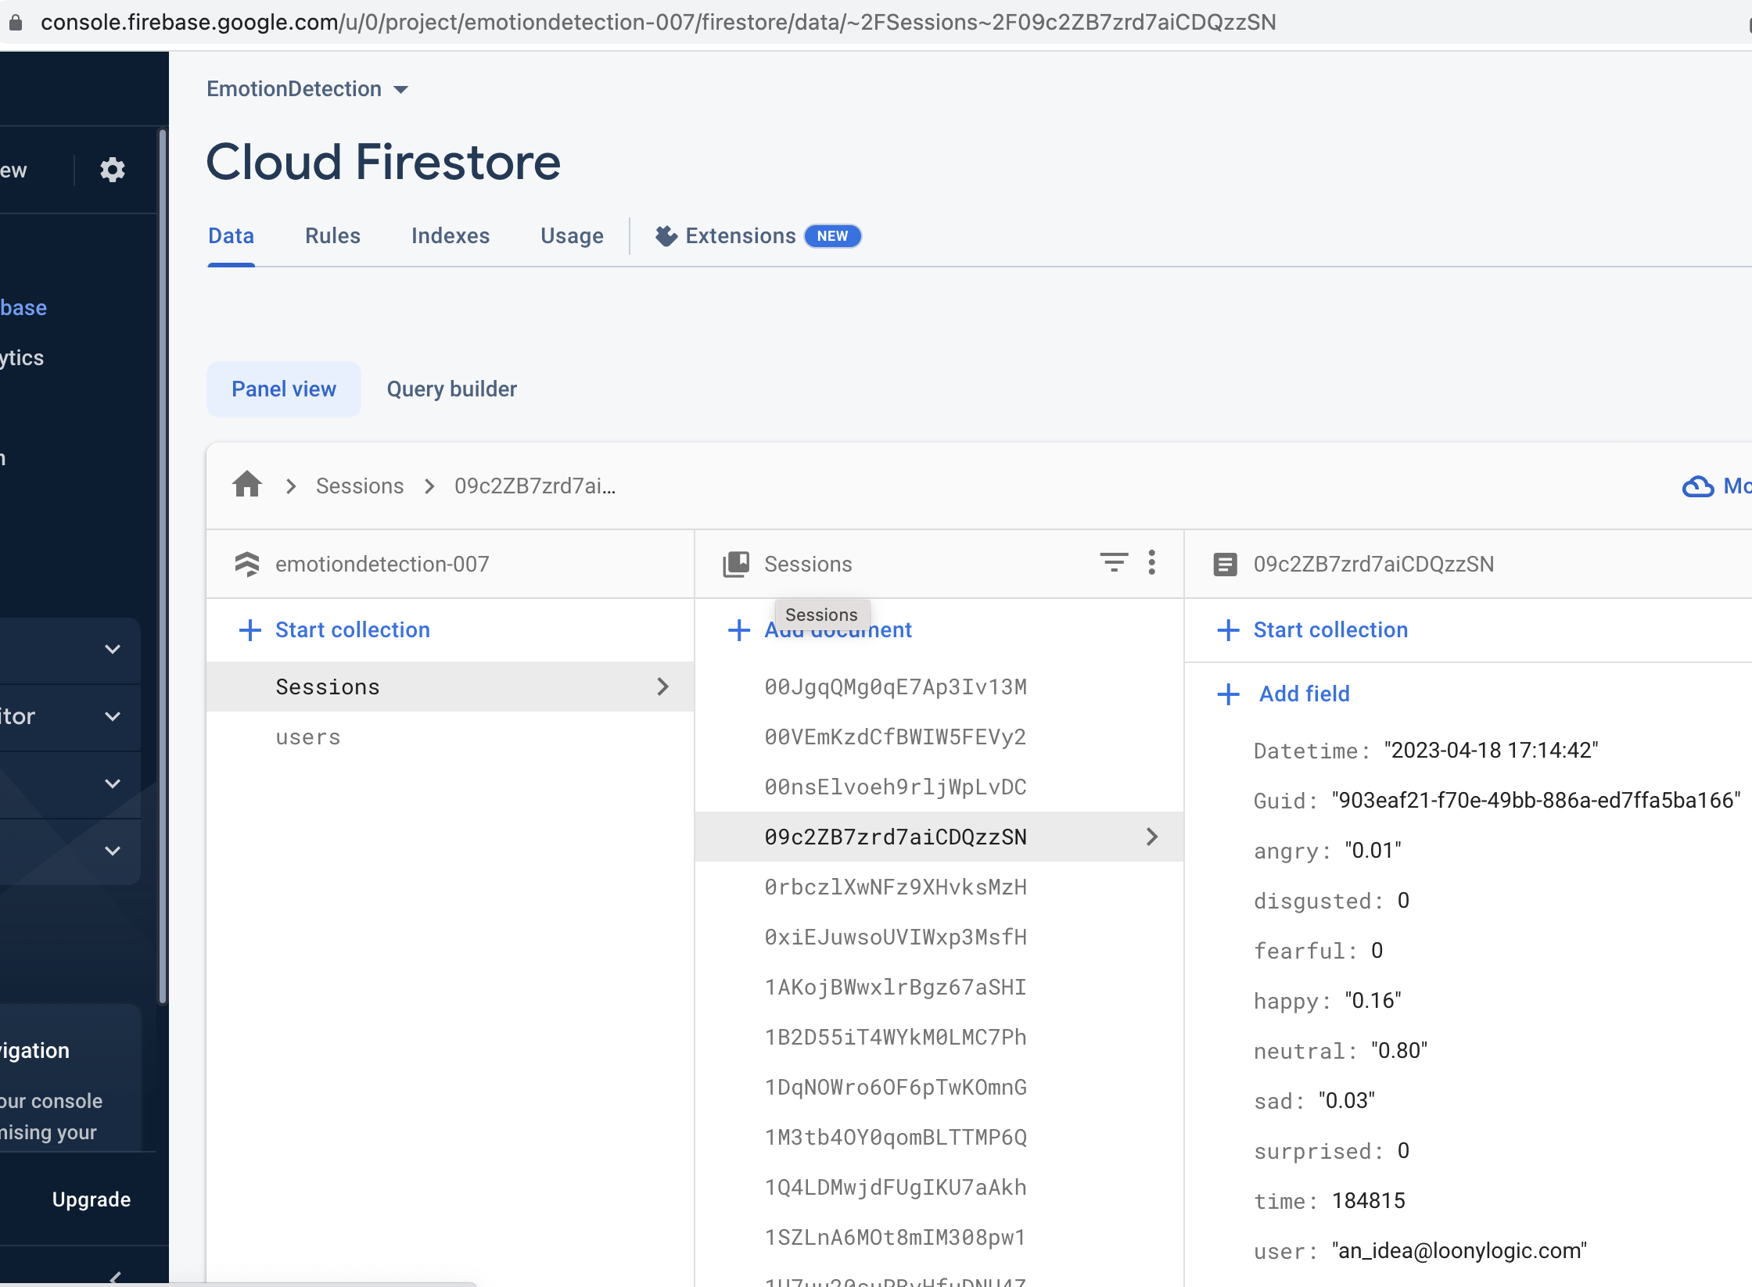
Fire Store
Fire store is a NoSQL document database provided by Firebase.
Each Session is stored in documents and retrieved for
Analytics.
Cloud functions are used to filter and manipulate raw data based on
End user requirements

Slide 15


Slide 16


